Slide 1
Keyword «this»
by Yaroslav Vendysh

Slide 2
«this» in methods
It’s common that an object method needs to access the information stored in the object.
To access the object, a method can use the this keyword.
The value of this is the object “before dot”, the one used to call the method.

Slide 3
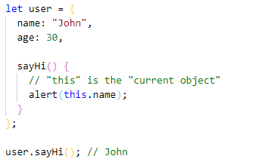
«this» in methods
For instance, the code inside user.sayHi() may need the name of the user:

Slide 4
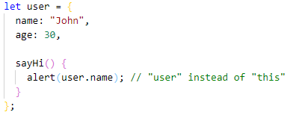
«this» in methods
Technically, it’s also possible to access the object without this:

Slide 5
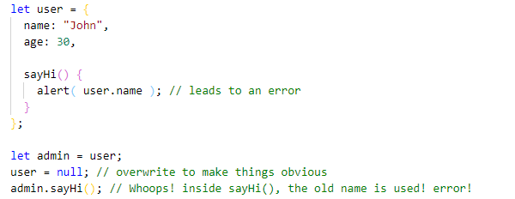
«this» in methods
But such code is unreliable. That’s demonstrated below:

Slide 6
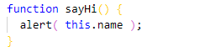
«this» is not bound
In JavaScript, keyword this behaves unlike most other programming languages.
It can be used in any function.
There’s no syntax error in the following example:

Slide 7
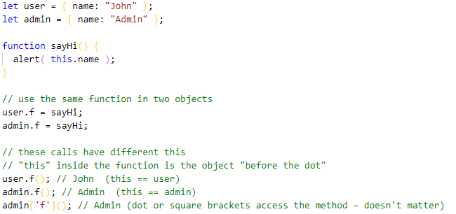
«this» is not bound
The value of this is evaluated during the run-time, depending on the context.

Slide 8
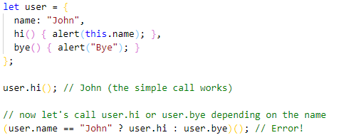
«this» and Reference Type
An intricate method call can lose this, for instance:

Slide 9
«this» and Reference Type
This works (object dot method):
This doesn’t (evaluated method):

Slide 10
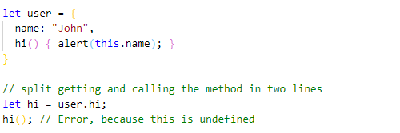
«this» and Reference Type
If we put these operations on separate lines, then this will be lost for sure:

Slide 11
«this» and Reference Type
To make user.hi() calls work, JavaScript uses a trick – the dot '.' returns not a function.
But a value of the special Reference Type.
The Reference Type is a “specification type”.
We can’t explicitly use it, but it is used internally by the language.

Slide 12

«this» and Reference Type
The value of Reference Type is a three-value combination (base, name, strict), where:
base is the object.
name is the property name.
strict is true if use strict is in effect.

Slide 13
«this» and Reference Type
Conclusion:
When parentheses() are called on the Reference Type, they receive the full information
about the object and its method, and can set the right this (=user in this case).
Any other operation like assignment hi=user.hi discards the reference type as a whole,
takes the value of user.hi (a function) and passes it on. So further operation “loses” this.

Slide 14
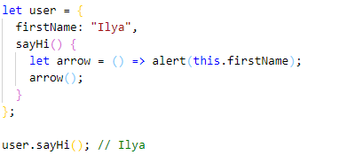
«this» and arrow functions
Arrow functions are special: they don’t have their “own” this.
If we reference this from such a function, it’s taken from the outer “normal” function.
For instance, here arrow() uses this from the outer user.sayHi() method:

Slide 15
«this» and constructor
When a function is executed with new, it does the following steps:
A new empty object is created and assigned to this.
The function body executes. Usually it modifies this, adds new properties to it.
The value of this is returned.

Slide 16
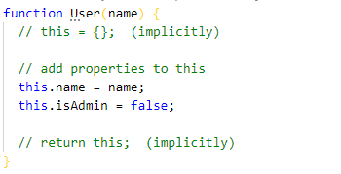
«this» and constructor
In other words, new User(...) does something like:

Slide 17
method «call»
Let’s say we have a function slow(x) which is CPU-heavy, but its results are stable.
In other words, for the same x it always returns the same result.
If the function is called often, we may want to cache (remember) the results.
It helps to avoid spending extra-time on recalculations.

Slide 18
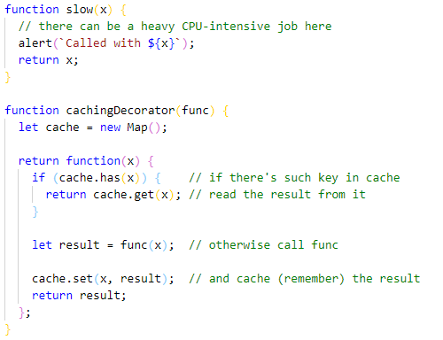
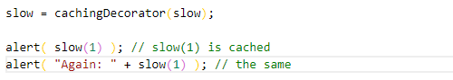
method «call» - example cache

Slide 19
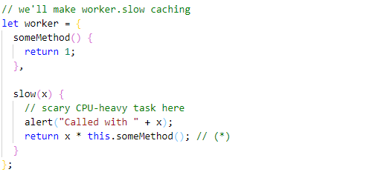
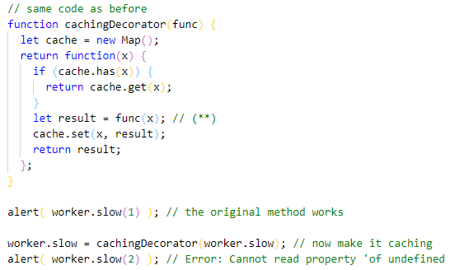
method «call» - example cache

Slide 20

method «call»
There’s a special built-in function method that allows to call a function explicitly setting this.
The syntax is:
It runs func providing the first argument as this, and the next as the arguments.

Slide 21
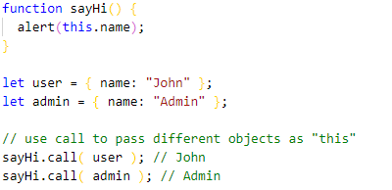
method «call»
As an example, in the code below we call sayHi in the context of different objects:
sayHi.call(user) runs sayHi providing this=user, and the next line sets this=admin:

Slide 22
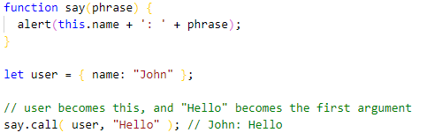
method «call»
And here we use call to call say with the given context and phrase:

Slide 23
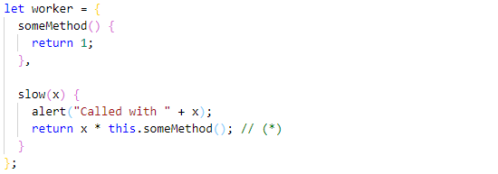
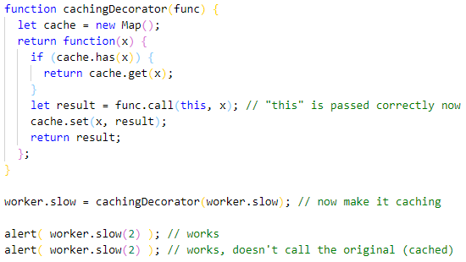
method «call» - example cache

Slide 24
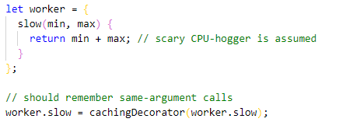
method «apply»
Now let’s make cachingDecorator even more universal.
Till now it was working only with single-argument functions.
Now how to cache the multi-argument worker.slow method?

Slide 25
method «apply» - example cache

Slide 26
method «apply»
Instead of func.call(this, ...arguments) we could use func.apply(this, arguments).
The syntax of built-in method func.apply is:
It runs the func setting this=context and using an array-like object as the list of arguments.

Slide 27
method «apply»
So these two calls are almost equivalent:
There’s only a minor difference:
The spread syntax ... allows to pass iterable args as the list to call.
The apply accepts only array-like args.

Slide 28
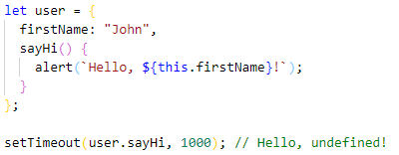
method «bind»
We’ve already seen examples of losing this.
Once a method is passed somewhere separately from the object – this is lost.
Here’s how it may happen with setTimeout:

Slide 29
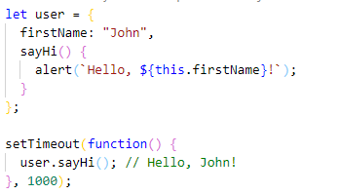
method «bind»
The simplest solution is to use a wrapping function:

Slide 30
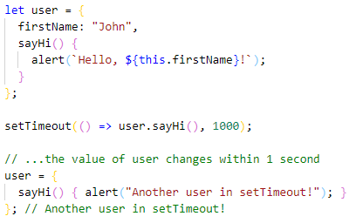
method «bind»
What if before setTimeout triggers (there’s one second delay!) user changes value?
Then, suddenly, it will call the wrong object!

Slide 31
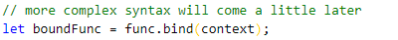
method «bind»
Functions provide a built-in method bind that allows to fix this.
The basic syntax is:
The result of func.bind(context) is a special function-like “exotic object”.
It is callable as function and transparently passes the call to func setting this=context.

Slide 32
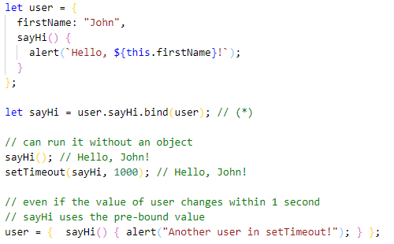
method «bind»
Now let’s try with an object method:

Slide 33
method «bind»
Until now we have only been talking about binding this. Let’s take it a step further.
We can bind not only this, but also arguments.
That’s rarely done, but sometimes can be handy.
The full syntax of bind:
It allows to bind context as this and starting arguments of the function.

Slide 34
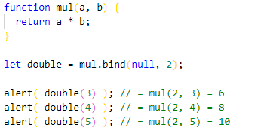
method «bind»
For instance, we have a multiplication function mul(a, b).
Let’s use bind to create a function double on its base:

Slide 35
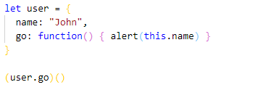

Check yourself ☺
What is the result of this code?
Solution: error.
The error appears because a semicolon is missing after user={...}.

Slide 36
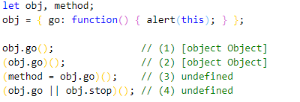
Check yourself ☺
In the code below we intend to call obj.go() method 4 times. Why result is different?
Solution: any operation on function except a method call (like assignment = or ||) turns it
into an ordinary value, which does not carry the information allowing to set this.

Slide 37
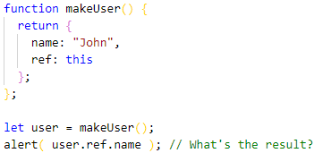
Check yourself ☺
Here the function makeUser returns an object. What is the result of accessing its ref? Why?
Solution: error.
Because rules that set this do not look at object definition. Only the moment of call matters.

Slide 38
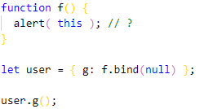
Check yourself ☺
What will be the output?
Solution: null.
The context of a bound function is hard-fixed. There’s just no way to further change it.

Slide 39
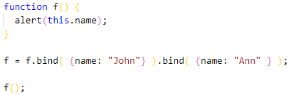
Check yourself ☺
What will be the output?
Solution: John.
Function object returned by f.bind(...) remembers the context only at creation time.

Slide 40
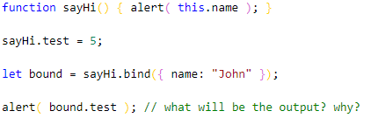
Check yourself ☺
What will be the output?
Solution: undefined.
The result of bind is another object. It does not have the test property.

Slide 41
Useful links
https://www.w3schools.com/js/js_this.asp
https://codeburst.io/all-about-this-and-new-keywords-in-javascript-38039f71780c
https://javascript.info/object-methods
https://javascript.info/constructor-new
https://javascript.info/call-apply-decorators
https://javascript.info/bind
https://javascript.info/arrow-functions

Slide 42
Thank you for attention
by Yaroslav Vendysh

